Slide 1
Infant weighing scale
principles of operation
function
use
scientific principles
construction
components
system diagram
inputs/outputs
troubleshooting
identifying common faults
replacing components
rectifying faults
safety considerations
user and patient safety
performance monitoring
calibration
18.3.5 Maintain an infant weighing scale
Unit C18.3 Maintaining Paediatrics Equipment
Module 279 19 C Medical Instrumentation II
©
dr. Chris R. Mol, BME, NORTEC, 2015

Slide 2
Function: measure weight
What is a scale ?
A scale is an accurate and precise instrument used to measure the weight (mass) of a material. The ability to measure material as large as 50kg and as small as 10μg makes them quite common.
Why is it important ?
In the hospital, many materials have to be measured, incl. patients, new-born babies, pharmaceutical drugs, …. to track the health situation (diagnosis) or apply therapies.
In what units do we measure mass and weight ?
The unit of the mass is the kilogram [kg]. It is equal to the mass of the international prototype kilogram and therefore fixed.
The unit of weight is the Newton, the force with which gravity exerts on a kg mass.
Weight = Mass x Gravity Constant. This varies by up to 0.5% at different locations on Earth.
Maintain a scale
dr. Chris R. Mol, BME, NORTEC, 2015

Slide 3
Infant weighing scale versus adult weighing scale
A baby scale is a specially-designed scale to monitor the progress of a baby’s physical development.
If a baby is born prematurely, it is often important to closely monitor their weight gain with a baby scale, more often than for on-time babies.
A major difference with the adult scale is that the baby cannot stand on his/her own. Special constructions have been created for this. For children who can stand independently, an adult scale is used.
Because babies have a lower weight, and weight is an important indicator of growth (and malnutrition) baby scales must be able to measure more accurately: better than 50 grams accuracy.
©
Infant weighing scale
dr. Chris R. Mol, BME, NORTEC, 2015

Slide 4
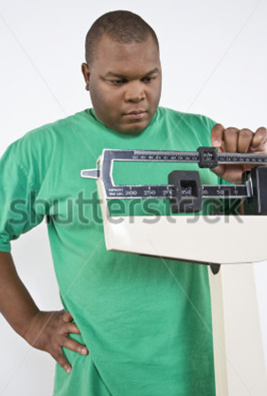
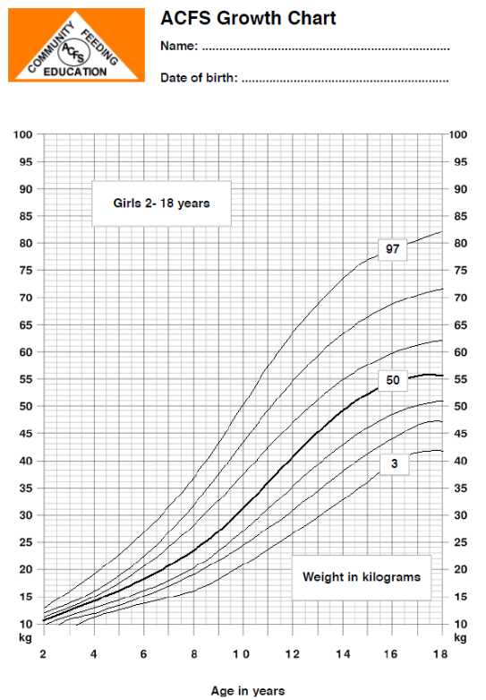
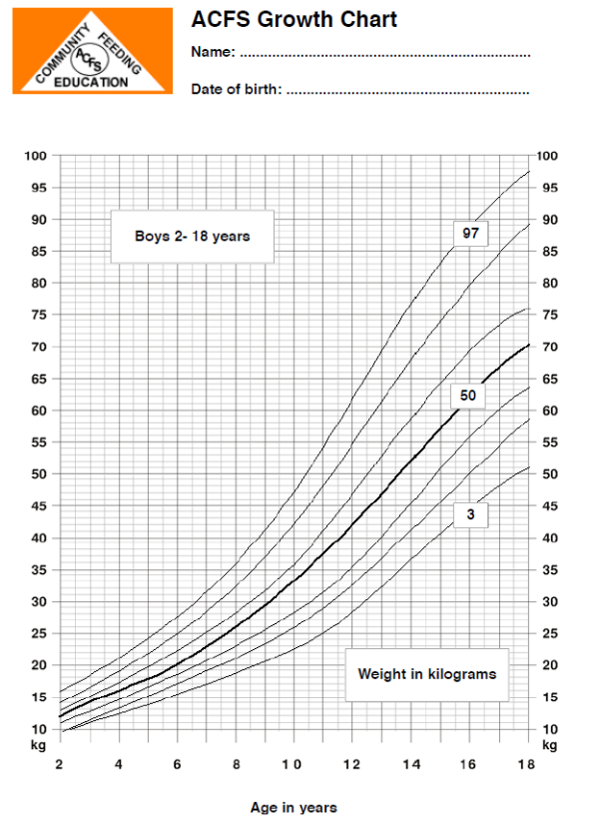
Paediatric use of Weighing Scales
from: African Children's Feeding Scheme
www.acfs.org.za
Children’s weight measurement is important in overcoming malnutrition
(and overweight)
Birth weight is the body weight of a baby at its birth
Infant weighing scale
dr. Chris R. Mol, BME, NORTEC, 2015

Slide 5
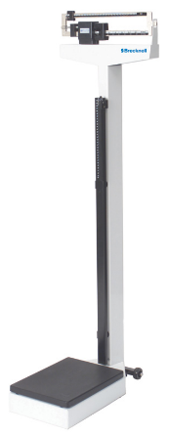
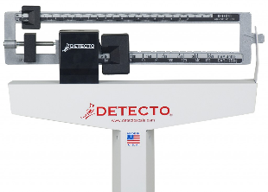
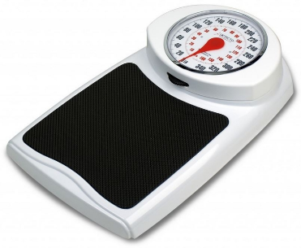
Adult weighing scales
‘bathroom scale’ with battery.
up to 150 kg
not precise enough for small babies
‘Physician’s scale’ with sliding beam:
up to 150 kg
accurate
Infant weighing scale
dr. Chris R. Mol, BME, NORTEC, 2015

Slide 6
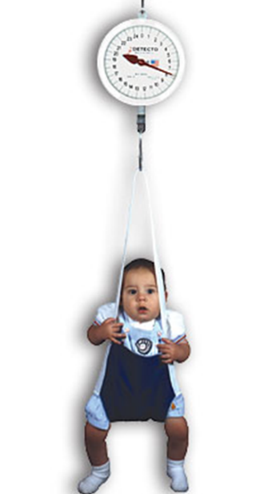
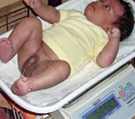
Paediatric weighing scales
hanging infant scale
up to 25 or 50 kg, age 5
low cost, portable but not accurate
basin type, table top, electronic scale
on battery or mains supply
basin type, table top, sliding beam scale
up to 16 kg with 10 gram graduations.
Babies only
Infant weighing scale
dr. Chris R. Mol, BME, NORTEC, 2015

Slide 7
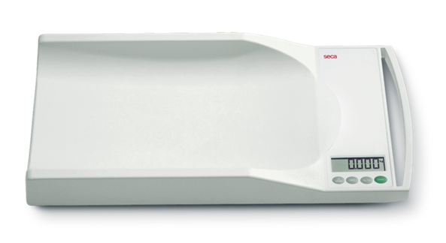
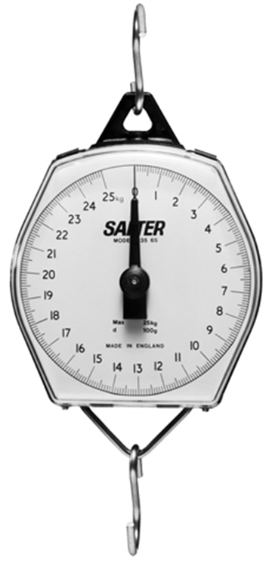
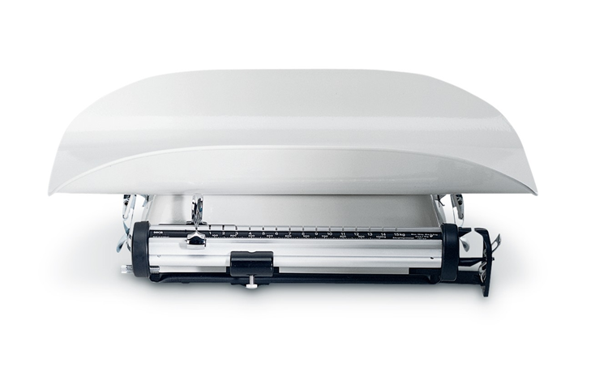
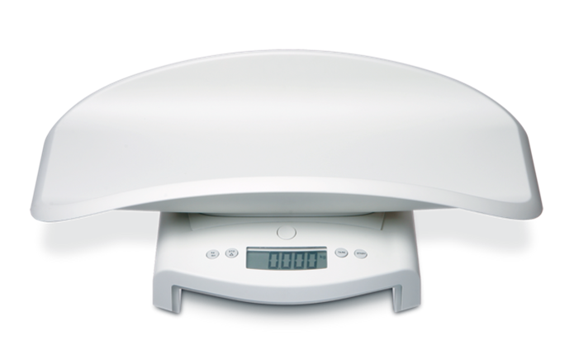
Paediatric weighing scales
‘mobile scale’
cost £60-£100 replacement every 2-4 years with heavy use.
hanging infant scale
Salter 235 6S model
basin type, table top, electronic
basin type, table top, sliding beam
Seca 725 model
Infant weighing scale
dr. Chris R. Mol, BME, NORTEC, 2015

Slide 8
Scales and Balances
The scale was the first mass measuring instrument invented. Traditionally, it consists of a pivoted horizontal lever with arms of equal length – the beam – and a weighing pan suspended from each arm. The unknown mass is placed in one pan and standard masses of known weight are added to the other pan until the beam is as close to equilibrium as possible.
Practical name giving:
scales are used for weighing larger masses like a bathroom scale or baby scale;
balances are used for precise weighing of substances, as such are used in laboratories.
Infant weighing scale
dr. Chris R. Mol, BME, NORTEC, 2015

Slide 9
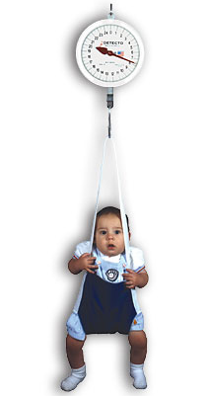
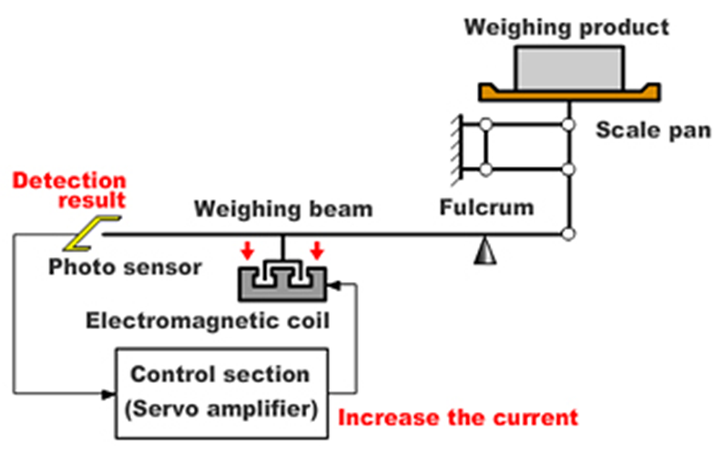
Mechanical and Electromagnetic Spring Scales
Mechanical scales consist of springs or lever arms, and calibrated by using known weights.
Electromagnetic scales are more complex and require electricity, but are generally more user friendly. They are often based on measuring the current needed to levitate the pan and mass.
Infant weighing scale
dr. Chris R. Mol, BME, NORTEC, 2015

Slide 10
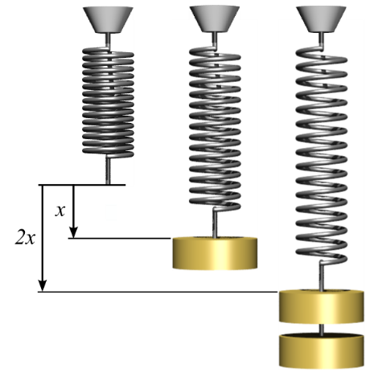
Spring behaviour: Hooke’s Law
The extension (x) of a spring is described by (Hooke's Law):
F = kx
F is the force k is the spring constant x is the distance the spring is extended
When you put an object on a spring scale, the object experiences a force (gravity pulling it toward the earth), by which the spring is extended. The amount of extension caused by a certain force depends on the material and manufacture of the spring and is unique for that spring: the spring constant (k).
Therefore the spring is the most important element of a commercial scale.
A spring scale can be damaged if the spring is pulled too far.
Infant weighing scale
dr. Chris R. Mol, BME, NORTEC, 2015

Slide 11
Preventive Maintenance
Little maintenance other than regular cleaning and calibration checks are required of the baby scales.
Infant weighing scale
dr. Chris R. Mol, BME, NORTEC, 2015

Slide 12
Trouble shooting
Mechanical scales
are very reliable and rarely need major repairs. The most common problem with mechanical scales is
environmental factors: the movements of the mechanical scale must be free of dirt and other residue
maintenance requiring cleaning and lubrication of all moving parts.
Electromagnetic spring scales
The most common problems associated with an electromagnetic balance are the result of
environmental factors
temperature,
static electricity,
vibration / movement
out of level (tilted)
wind.
user error
Internal problems with an electromagnetic scale cannot usually be repaired in the field.
Infant weighing scale
dr. Chris R. Mol, BME, NORTEC, 2015

Slide 13
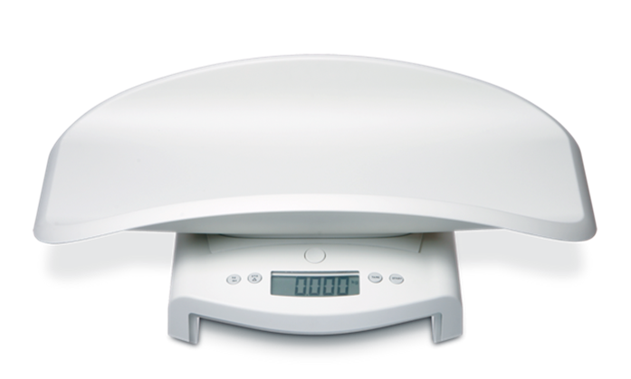
Calibration: Zero setting
Most electronic scales calibrate themselves when turned on
The hanging infant scale must be calibrated before each use: scale must be set to zero with the adjustment wheel before the baby is introduced.
Infant weighing scale
dr. Chris R. Mol, BME, NORTEC, 2015

Slide 14
Calibration
Calibration of the scales should be undertaken at least weekly and as required; for example if an error in a weight measurement is suspected.
The scales can be checked by placing an approved weight on the scales e.g. 1kg, 2kg, 5kg and 10kg weights. It is recommended that checks be carried out at three weight points on scales, using:
a minimum of 80% of maximum weight capacity for the scale, and
a point about half of the above measurement (i.e. approximately 40% of max.), and
a point much lower down the scale range
©
Infant weighing scale
dr. Chris R. Mol, BME, NORTEC, 2015

Slide 15
Safety Considerations: Infection
A new paper towel should be placed on the scales between clients (Australia).
The scales should be cleaned weekly at a minimum or as required with detergent / disinfectant wipes and allowed to air dry.
©
Infant weighing scale
dr. Chris R. Mol, BME, NORTEC, 2015

Slide 16
END
The creation of this presentation was supported by a grant from THET:
see https://www.thet.org/

